Slide 1


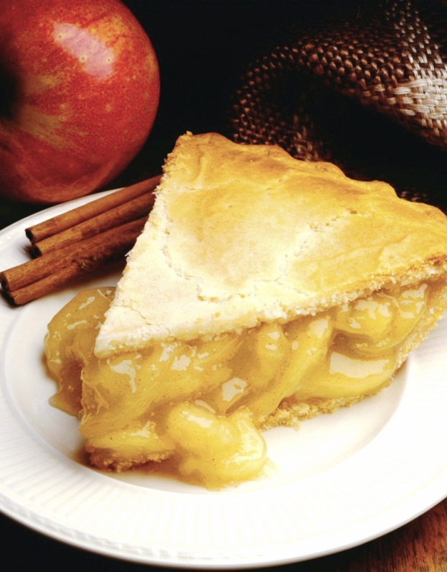
Nutrition Database Goel big or Goel home
Created by Elton Vinh, Joanne Trinh, Gordon Wang, Ethan Huang, Loc Giang, Shyanaka Ramachandra

Slide 2
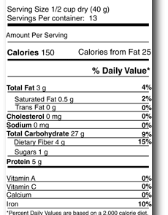
Project Application
This project is a database of food and its nutritional information.

Slide 3
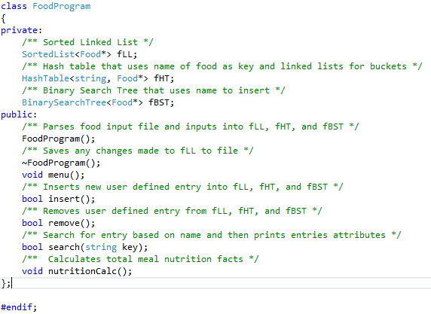
Overview and Features
Food nutrition
Database
Insert
Remove
Search
calculate
HashTable
BST
Sorted Linked List

Slide 4
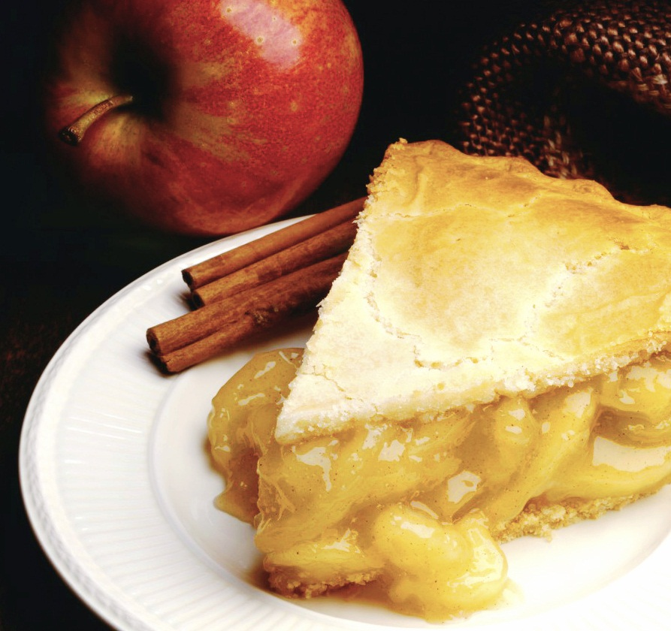
Menu Options
Add new food data
Delete food data
Look up food data
List food data in hash table sequence
List food data sorted by name
Print Indented tree
Print efficiency data of hash table
Food calculator
Quit

Slide 5
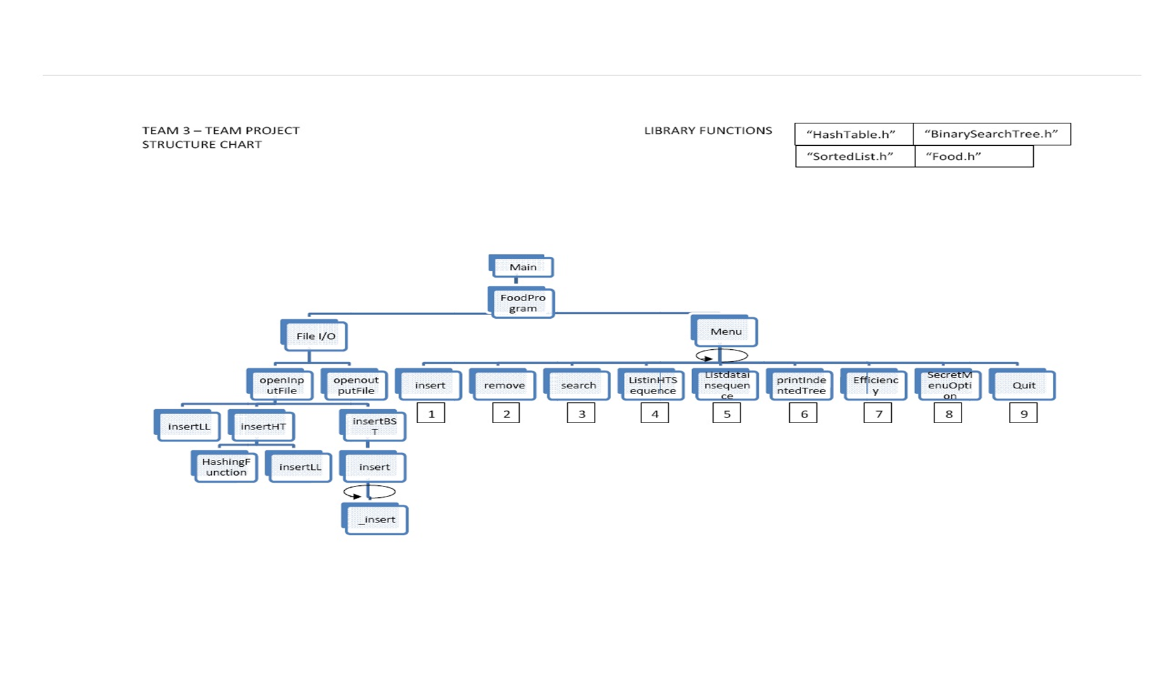

Slide 6
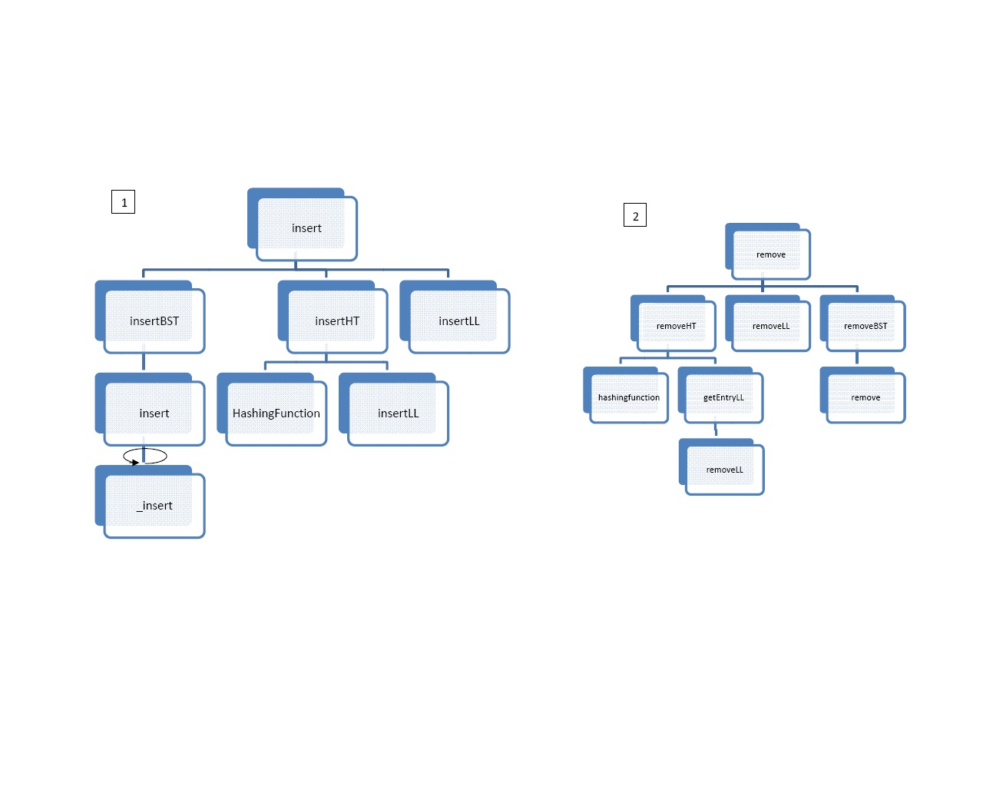
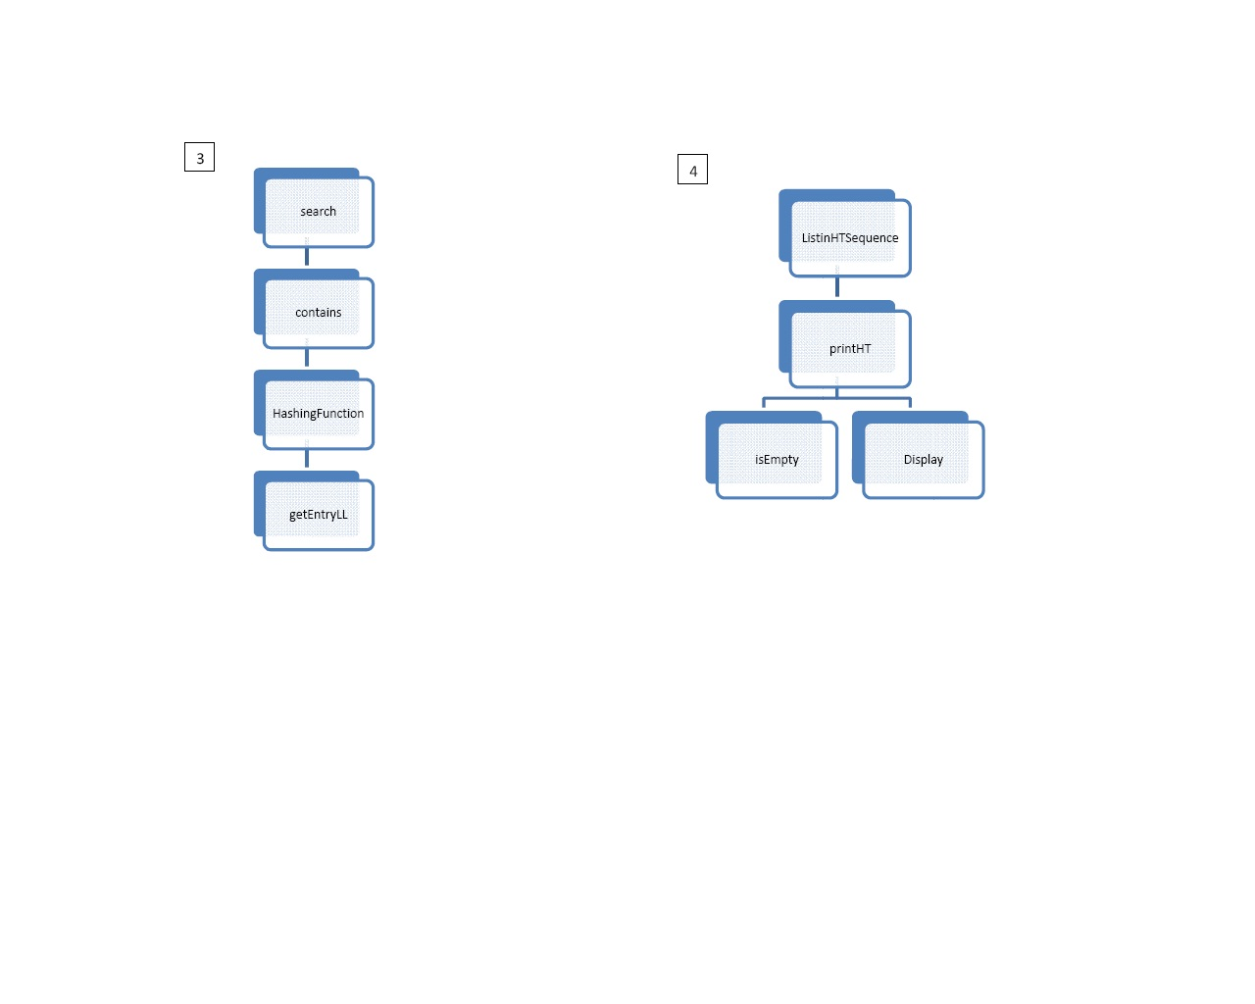

Slide 7
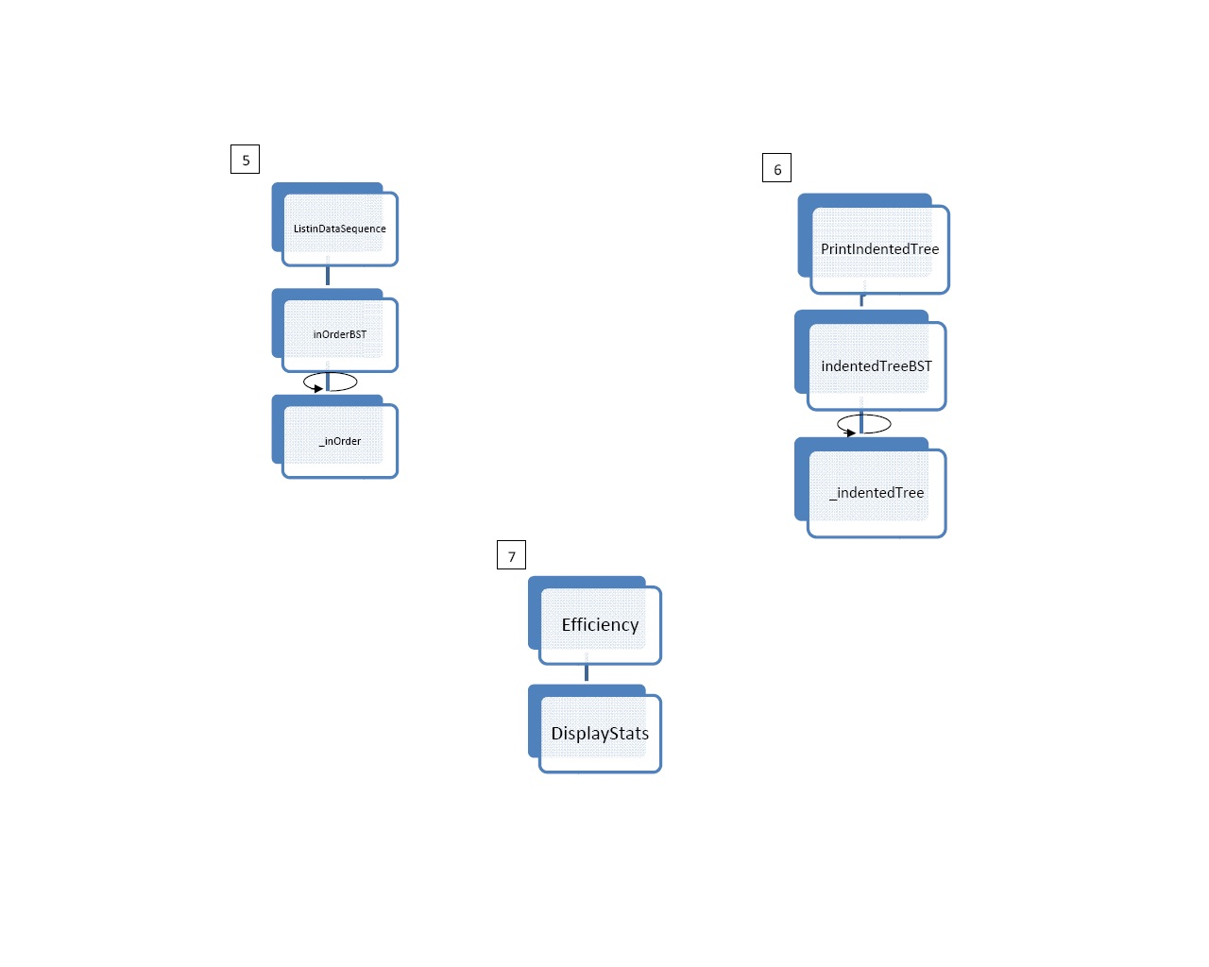
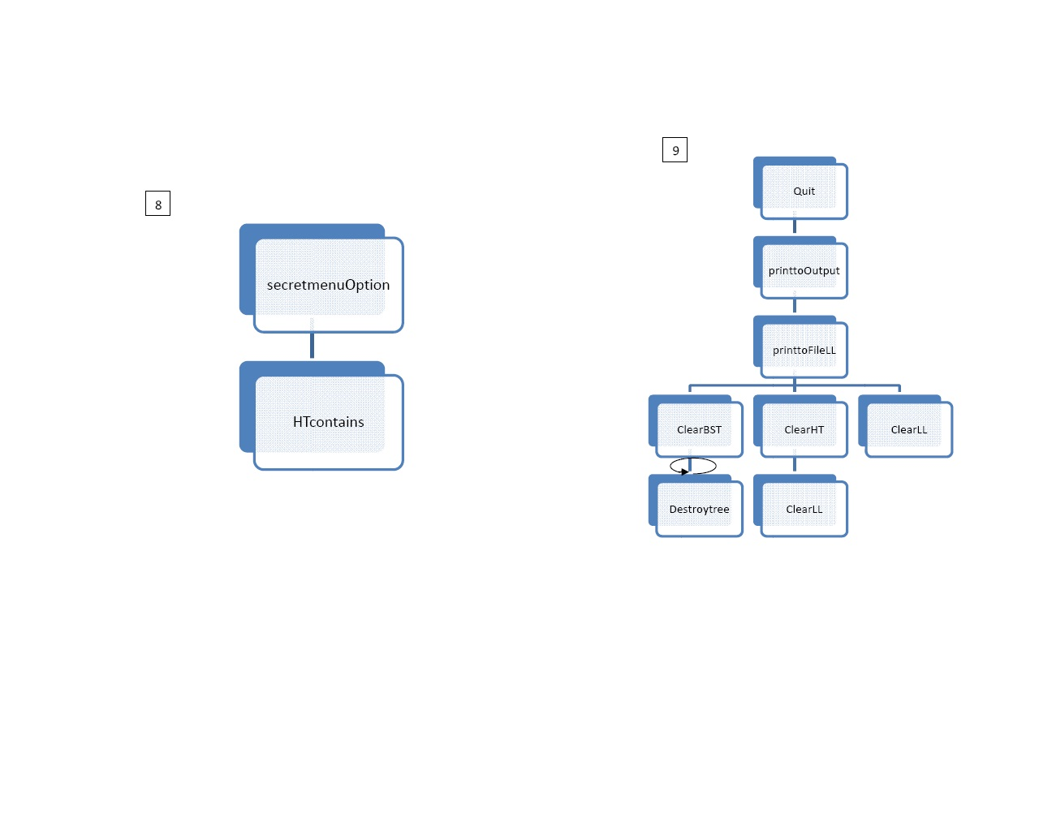

Slide 8

Data Record
Attributes
Name = Tomato
Calories = 15
Total Fat(mg) = 181
Cholesterol(g) = 0
Sodium(mg) = 18
Protein(mg) = 879
Functions
constructors and destructors
getters and setters
overloaded operators

Slide 9
File IO
Name | Calories | Total Fat | Cholesterol | Sodium | Protein
Tomato | 22 | 0.2 | 0 | 6.2 | 1.1
Whole Milk | 148 | 7.9 | 24.4 | 104.9 | 7.7
White Bread | 79 | 1 | 0 | 147.3 | 2.7

Slide 10
Data Structures
fBST
FoodProgram
Lptr
Fptr
Rptr
fBST
fHT
fLL
fHT
Lptr
Fptr
Rptr
Lptr
Fptr
Rptr
0
fLL
1
fLL
2
fLL
n
fLL
fLL

Slide 11
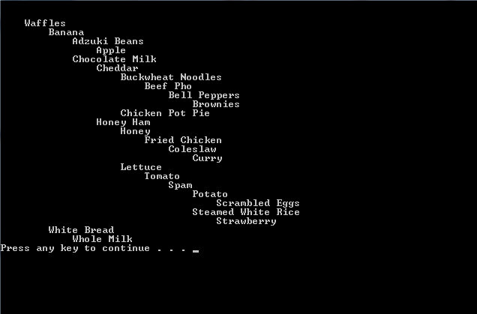
Binary Search Tree
Search filters
Print Ascending order
Indented Print
Visual way to show the levels of the binary search tree.

Slide 12
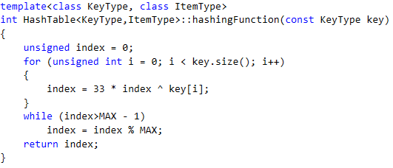
Hash Function code
Takes the key and does a for loop the length of the key.
This hash function performs an exclusive OR binary function on the previously index calculated index and the Ascii code of the current letter (if using string) or number
The while loop insures that the corresponding index of the item does not exceed the max value of the table.
hashingFunction(key:KeyType):int
i = index position for ( index position < length of key; i++)
‌ Index = prime number * index ^ key[i]
while( index > sizeOfTable - 1)
index = index mod sizeFfTable
return index

Slide 13

Sorted Linked List
The Sorted Linked List is our method for collision resolution
We create an array of sorted lists. The hash function determines the index of the array.
If the index is not used, we create a new linked list in the array. If the index is used, we add an additional node to the linked list.

Slide 14
Key Design Efficiencies
Separated menu from main and enabled FoodProgram as ADT
Collision Resolution is a sorted linked list.
We use HashTable for searching for specific objects
We used one BST that rearranges based on key attribute instead of building several BSTs

